Slide 1
Database Management System
October 2014, Reviewed: July 2015

Slide 2

Agenda
Definitions
What is Database
What is DBMS
Database Models
Entity Relationship Diagram
Database Objects
General Data Types

Slide 3
Definitions

Slide 4
What is database
A database is an organized collection of data.
A database is a collection of information that is organized so that it can easily be accessed, managed, and updated.

Slide 5
What is DBMS
Database management systems (DBMSs) are specially designed software applications that interact with the user, other applications, and the database itself to capture and analyze data.
E.g.: MySQL, PostgreSQL, Microsoft SQL Server, Oracle etc.
Notes:
Database management systems (DBMSs) are specially designed software applications that interact with the user, other applications, and the database itself to capture and analyze data. A general-purpose DBMS is a software system designed to allow the definition, creation, querying, update, and administration of databases. Well-known DBMSs include MySQL, PostgreSQL, Microsoft SQL Server, Oracle, SAP and IBM DB2. A database is not generally portable across different DBMSs, but different DBMSs can interoperate by using standards such as SQL and ODBC or JDBC to allow a single application to work with more than one DBMS. Database management systems are often classified according to the database model that they support; the most popular database systems since the 1980s have all supported the relational model as represented by the SQL language.
References:
http://www.tutorialspoint.com/dbms/

Slide 6



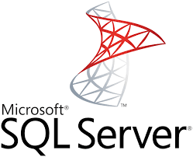


Logos

Slide 7
DBMS purpose
To store data properly
To provide simultaneous access to the data for many users
To delimit the access to the data for different users
To prevent data from loss

Slide 8
Database Models

Slide 9
Relational and non-relational DBs
A database model is a type of data model that determines the logical structure of a database and fundamentally determines in which manner data can be stored, organized, and manipulated.
Relational model (the eldest and the most popular),
object-oriented,
document,
hierarchical,
network model etc.
Basing on those models, there are relational and non-relational DBs and DBMSs

Slide 10
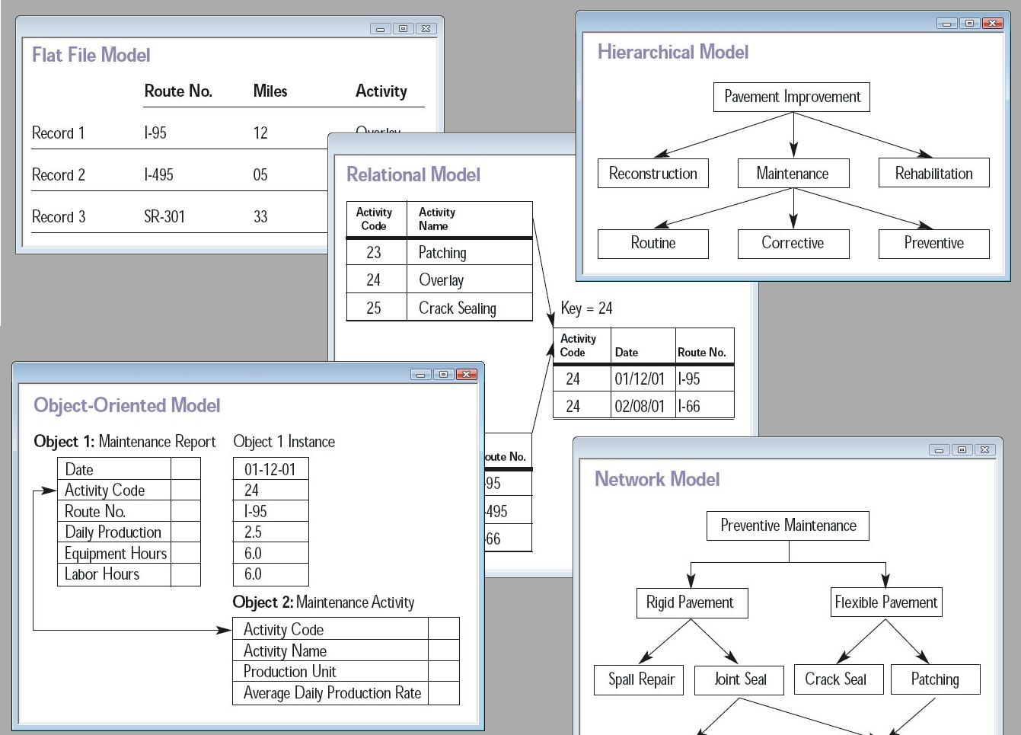
Database models

Slide 11
Relational model
Data is stored in tables called relations.
Relations can be normalized.
In normalized relations, values saved are atomic values.
Each row in relation contains unique value
Each column in relation contains values from a same domain
Notes:
The most popular data model in DBMS is Relational Model. It is more scientific model then others. This model is based on first-order predicate logic and defines table as an n-ary relation.
The main highlights of this model are:
Data is stored in tables called relations.
Relations can be normalized.
In normalized relations, values saved are atomic values.
Each row in relation contains unique value
Each column in relation contains values from a same domain.
Relational Model is explained here.

Slide 12
RDBMS
Inplement a relational data model
Are used in most commercial projects
Have been used for almost 40 years
Notes:
relational database management systems

Slide 13
Desktop RDBMS
Store data on local PC or network file storage
Data processing is performed on the local PC
Are used for small applications, mostly single-user, without strong security requirements
Example: Microsoft Access

Slide 14
Client-server RDBMS
Consist of two components: client and server
Example: Microsoft SQL Server, Oracle, MySql, Firebird, PostgreSQL
Client
Sends a query for data
Server
Streams data according to criteria

Slide 15
Entity Relationship Diagram

Slide 16
What is Entity
Entity it’s a real-world thing either animate or inanimate that can be easily identifiable and distinguishable.
Students
School DB
Teachers
Classes
Courses
Entities
Notes:
A real-world thing either animate or inanimate that can be easily identifiable and distinguishable.
For example, in a school database, student, teachers, class and course offered can be considered as entities. All entities have some attributes or properties that give them their identity.
An entity set is a collection of similar types of entities. Entity set may contain entities with attribute sharing similar values. For example, Students set may contain all the student of a school; likewise Teachers set may contain all the teachers of school from all faculties. Entities sets need not to be disjoint.

Slide 17
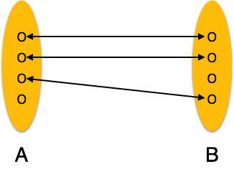
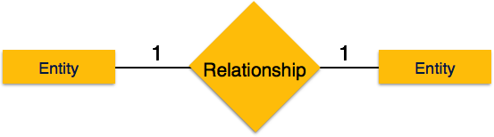
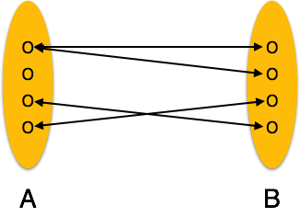
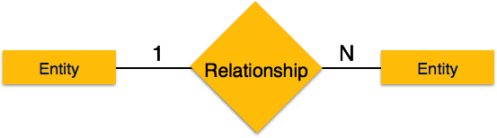
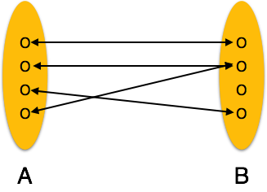
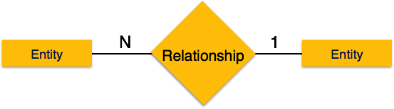
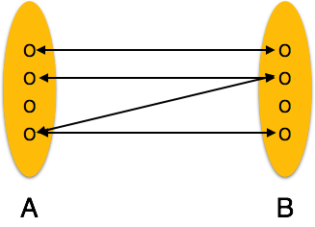

What is Relationship
The association among entities is called relationship
One-to-one: one entity from entity set A can be associated with at most one entity of entity set B and vice versa.
One-to-many: One entity from entity set A can be associated with more than one entities of entity set B but from entity set B one entity can be associated with at most one entity
Many-to-one: More than one entities from entity set A can be associated with at most one entity of entity set B but one entity from entity set B can be associated with more than one entity from entity set A.
Many-to-many: one entity from A can be associated with more than one entity from B and vice versa.
Notes:
The association among entities is called relationship. For example, employee entity has relation works_at with department. Another example is for student who enrolls in some course. Here, Works_at and Enrolls are called relationship.
Cardinality defines the number of entities in one entity set which can be associated to the number of entities of other set via relationship set.
The right one images on the slide show how corresponding relations are presented on the Entity Relationship diagram.

Slide 18
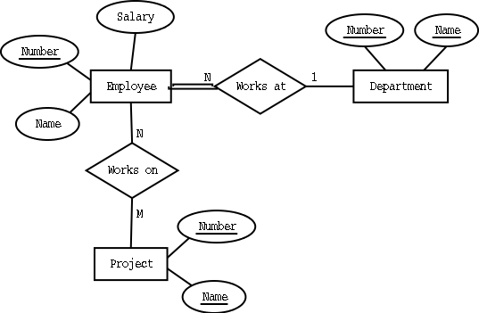
Entity Relationship Diagram
ER Model when conceptualized into diagrams gives a good overview of entity-relationship, which is easier to understand.
ER Diagrams mainly comprised of:
Entity and its attributes;
Relationship, which is association among entities.
Notes:
Relational data model is the primary data model, which is used widely around the world for data storage and processing. This model is simple and have all the properties and capabilities required to process data with storage efficiency.
Tables: In relation data model, relations are saved in the format of Tables. This format stores the relation among entities. A table has rows and columns, where rows represent records and columns represents the attributes.
Tuple: A single row of a table, which contains a single record for that relation is called a tuple.
Relation instance: A finite set of tuples in the relational database system represents relation instance. Relation instances do not have duplicate tuples.
Relation schema: This describes the relation name (table name), attributes and their names.
Relation key: Each row has one or more attributes which can identify the row in the relation (table) uniquely, is called the relation key.
Attribute domain: Every attribute has some pre-defined value scope, known as attribute domain
ER Model when conceptualized into diagrams gives a good overview of entity-relationship, which is easier to understand.
ER diagrams can be mapped to Relational schema that is, it is possible to create relational schema using ER diagram.
Though we cannot import all the ER constraints into Relational model but an approximate schema can be generated.
There are more than one processes and algorithms available to convert ER Diagrams into Relational Schema. Some of them are automated and some of them are manual process. We may focus here on the mapping diagram contents to relational basics.

Slide 19
Database Objects

Slide 20
Main Database Objects
Typical relational database contains:
Tables
Views
Stored procedures
Triggers
Keys
Indexes
etc.

Slide 21
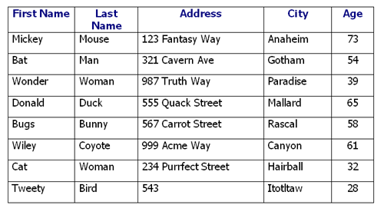
Tables
A table is a collection of related data held in a structured format within a database. It consists of fields (columns), and rows

Slide 22
Keys
Keys are, as their name suggests, a key part of a relational database and a vital part of the structure of a table. They ensure each record within a table can be uniquely identified by one or a combination of fields within the table. They help enforce integrity and help identify the relationship between tables.

Slide 23
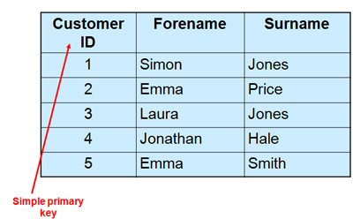
Primary Key
Primary key is the field that uniquely identifies the table row. Traditionally, this field is named ID or <TableName>ID

Slide 24
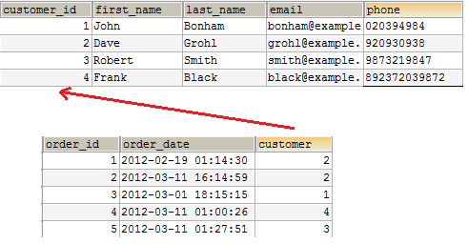
Foreign Key
The foreign key field is a field that references the primary key field of another table. It is used for creating relationships between tables

Slide 25
Indexes
A database index is a data structure that improves the speed of data retrieval operations on a DB table at the cost of additional writes and storage space to maintain the index data structure.
Indexes are used to quickly locate data without having to search every row in a database table every time a database table is accessed.

Slide 26
Views
A Database View is a subset of the database sorted and displayed in a particular way
View is the result set of a stored query on the data, which the database users can query just as they would in a persistent database collection object
Notes:
View is the result set of a stored query on the data, which the database users can query just as they would in a persistent database collection object. This pre-established query command is kept in the database dictionary. Unlike ordinary base tables in a relational database, a view does not form part of the physical schema: as a result set, it is a virtual table computed or collated dynamically from data in the database when access to that view is requested. Changes applied to the data in a relevant underlying table are reflected in the data shown in subsequent invocations of the view

Slide 27
Stored Procedures
A stored procedure is a subroutine available to applications that access a relational database system
Usually is written in special language which is the extension of SQL.
For MS SQL Server this language is called Transact-SQL
Notes:
A stored procedure is a subroutine available to applications that access a relational database system. A stored procedure (sometimes called a proc, sproc, StoPro, StoredProc, StoreProc, sp or SP) is actually stored in the database data dictionary.
Typical use for stored procedures include data validation (integrated into the database) or access control mechanisms. Furthermore, stored procedures can consolidate and centralize logic that was originally implemented in applications. Extensive or complex processing that requires execution of several SQL statements is moved into stored procedures, and all applications call the procedures. One can use nested stored procedures by executing one stored procedure from within another.

Slide 28
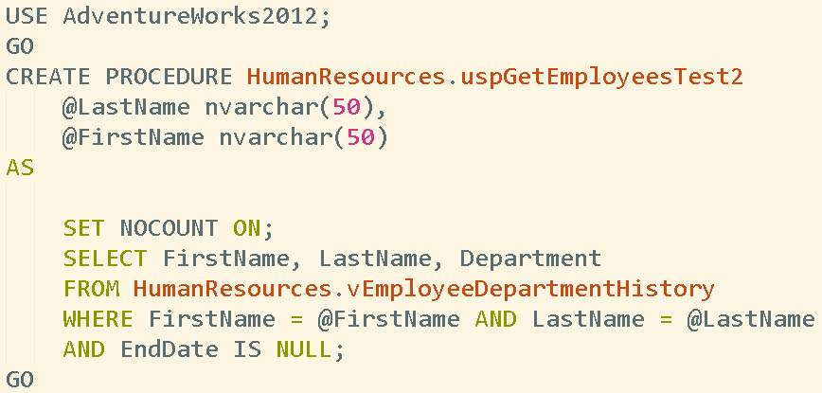
Stored Procedures Creation

Slide 29
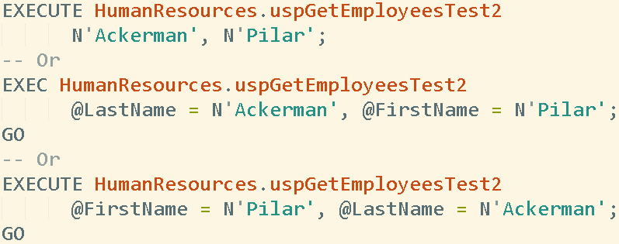
Stored Procedures Execution

Slide 30
Triggers
A database trigger is procedural code that is automatically executed in response to certain events on a particular table or view in a database.
The trigger is mostly used for maintaining the integrity of the information on the database.
Notes:
A database trigger is procedural code that is automatically executed in response to certain events on a particular table or view in a database. The trigger is mostly used for maintaining the integrity of the information on the database. For example, whe
Advantages of using SQL trigger
SQL Trigger provides an alternative way to check integrity.
SQL trigger can catch the errors in business logic in the database level.
SQL trigger provides an alternative way to run scheduled tasks. With SQL trigger, you don’t have to wait to run the scheduled tasks. You can handle those tasks before or after changes being made to database tables.
SQL trigger is very useful when you use it to audit the changes of data in a database table.
Disadvantages of using SQL trigger
SQL trigger only can provide extended validation and cannot replace all the validations. Some simple validations can be done in the application level. For example, you can validate input check in the client side by using javascript or in the server side by server script using PHP or ASP.NET.
SQL Triggers executes invisibly from client-application which connects to the database server so it is difficult to figure out what happen underlying database layer.
SQL Triggers run every updates made to the table therefore it adds workload to the database and cause system runs slower.
n a new record (representing a new worker) is added to the employees table, new records should also be created in the tables of the taxes, vacations and salaries.

Slide 31
Visual tools for working with RDBMS
There are some visual tools that allow to manipulate DB objects, administer the DB and execute SQL statements and program scripts.
MS SQL Server Management Studio

Slide 32
General Data Types

Slide 33
Data Types
Data types | Description
CHARACTER(n) | Character string. Fixed-length n
VARCHAR(n) or CHARACTER VARYING(n) | Character string. Variable length. Maximum length n
BOOLEAN | Stores TRUE or FALSE values
INTEGER(p) | Integer numerical (no decimal). Precision p
INTEGER | Integer numerical (no decimal). Precision 10
BIGINT | Integer numerical (no decimal). Precision 19
DECIMAL(p,s) NUMERIC(p,s) | Exact numerical, precision p, scale s. Example: decimal(5,2) is a number that has 3 digits before the decimal and 2 digits after the decimal
FLOAT(p) | Approximate numerical, mantissa precision p. A floating number in base 10 exponential notation. The size argument for this type consists of a single number specifying the minimum precision
DATE | Stores year, month, and day values
TIME | Stores hour, minute, and second values
Notes:
Each column in a database table is required to have a name and a data type.
SQL developers have to decide what types of data will be stored inside each and every table column when creating a SQL table.
The data type is a label and a guideline for SQL to understand what type of data is expected inside of each column, and it also identifies how SQL will interact with the stored data.

Slide 34
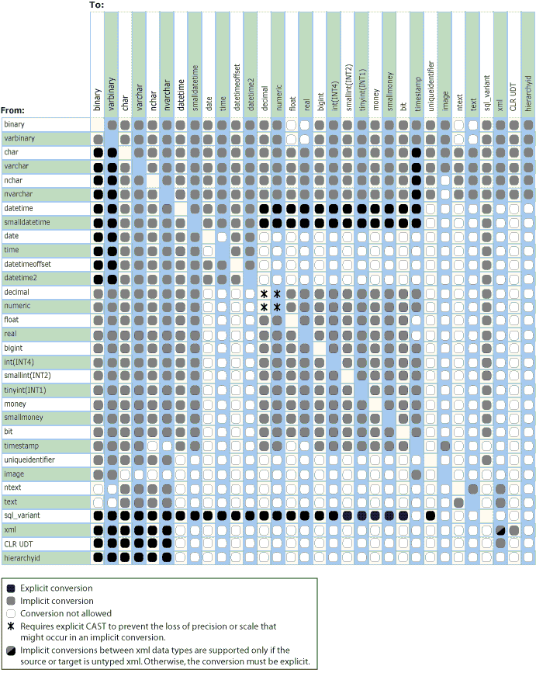
Data Type Conversion
Notes:
When data from one object is moved to, compared with, or combined with data from another object, the data may have to be converted from the data type of one object to the data type of the other.
Implicit conversions are not visible to the user. SQL Server automatically converts the data from one data type to another. For example, when a smallint is compared to an int, the smallint is implicitly converted to int before the comparison proceeds.
GETDATE() implicitly converts to date style 0. SYSDATETIME() implicitly converts to date style 21.
Explicit conversions use the CAST or CONVERT functions.
The CAST and CONVERT functions convert a value (a local variable, a column, or another expression) from one data type to another. For example, the following CAST function converts the numeric value of $157.27 into a character string of '157.27': CAST ( $157.27 AS VARCHAR(10) )
Use CAST instead of CONVERT if you want Transact-SQL program code to comply with ISO. Use CONVERT instead of CAST to take advantage of the style functionality in CONVERT.

Slide 35
Thank you
US OFFICES
Austin, TX
Fort Myers, FL
Boston, MA
Newport Beach, CA
Salt Lake City, UT
EUROPE OFFICES
United Kingdom
Germany
The Netherlands
Ukraine
Bulgaria
EMAIL
info@softserveinc.com
WEBSITE:
www.softserveinc.com
USA TELEPHONE
Toll-Free: 866.687.3588
Office: 239.690.3111
UK TELEPHONE
Tel: 0207.544.8414
GERMAN TELEPHONE
Tel: 0692.602.5857

